Slide 1
PARENT ORIENTATION

Slide 2
WELCOME Dear Parents, Welcome to Green Eggs Early Childhood Centre, we look forward to getting to know your family and we sincerely hope that your stay with us will prove both enjoyable and rewarding. Please allow 10 minutes to review the important parent orientation information contained in this Slideshow. As always, we are available to answer any questions that you may have about this orientation or any other matter regarding Green Eggs.

Slide 3
SIGN IN/OUT PROCEDURE
Signing children in and out of the Centre is extremely important for the following reasons:
Health and Safety – it records all children in attendance
Centrelink – Parents or Guardians are only eligible for Child Care Subsidy for days where their child has been signed in and out or marked as absent and signed. This means that parents must sign for all booked days (including absences)
We use an electronic sign in system at Green Eggs Early Childhood Centre. This system is called OWNA.
It is important for all families to download and access the OWNA Parent App prior to their child’s first day of attendance.

Slide 4
OWNA – PARENT KIOSK

Slide 5
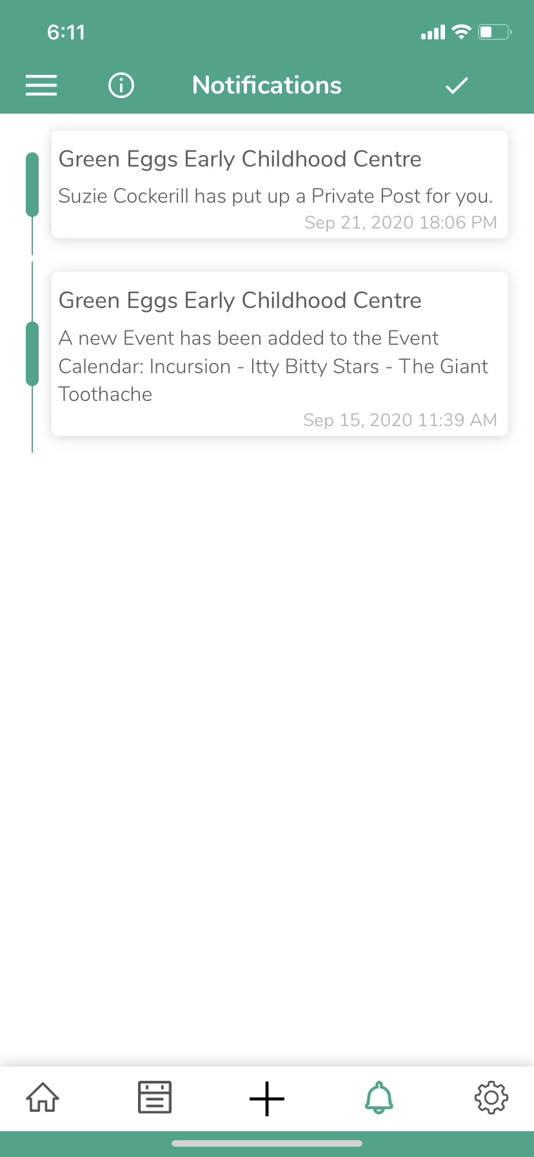
OWNA – PARENT MESSAGES
Note: Families should ensure that notifications are allowed and switched on for the OWNA App (via phone settings)
One of the ways that we can send short messages and alerts to parents is via the OWNA App.
To see Notifications- select the “bell” within the OWNA App (tool bar at bottom of page). New notifications will be shown with a red number beside the bell…

Slide 6
COMMUNICATION
Communicating effectively and in a timely manner with families is extremely important to us. We use the following methods to keep families informed:
OWNA allows for two way communication between educators and parents and is a portal for important centre information. This is our primary form of communication.
Email our email addresses are:
director@greeneggschildcare.com.au (Centre Director)
admin@greeneggschildcare.com.au (Centre Admin)
suzie@greeneggschildcare.com.au (Owner)
toddlers@greeneggchildcare.com.au (Toddlers Room)
seniortoddlers@greeneggschildcare.com.au (Senior Toddlers Room)
prekindy@greenggschildcare.com.au (PreKindy Room)
kindergarten@greeneggschildcare.com.au (Kindergarten Room)
Newsletters - we send out a quarterly newsletter via OWNA at the start of each term. (previous newsletters can be retrieved from this parent portal)
Facebook – http://www.facebook.com/GreenEggsChildCare
Open Door Policy – we will always make ourselves available for face-to-face parent meetings

Slide 7
Parent Forms and Notice Periods
Parent Forms can be obtained in OWNA.
Parent forms are required to advise us in writing of termination or change in enrolment (days), grievances etc. In lieu of forms, we will also accept emails (however where information is missing, clarification may need to be sought)
Two weeks notice
Two week’s advance notice in writing of any cancellation or change to bookings is required.
Fees will be charged in lieu of notice.
Note that Child Care Subsidy (CCS) entitlements will cease on your last day of attendance at the centre.

Slide 8
Holidays & Absences
Holiday Subsidy
Holiday rates are available at a subsidised rate of $10.00 per day (reduction on full rate), for all leave (excluding public holidays). Holiday relief is available provided that:
two weeks notice in writing is given – via OWNA
fees are up to date at the commencement of the holiday period i.e. two weeks in advance.
Allowable Absences
Parents who receive government assistance are entitled to 42 days of government subsidised fees (CCS) for absences (including holidays & public holidays) per financial year, after which full fees may be payable. Once your 42 days absence quota has been reached, additional absences may be subsidised with supporting documentation ie medical certificates for absences due to illness, when submitted, will ensure that you receive CCS for these additional absences.
Note that your child’s accumulated absences are included on weekly statements. This data is maintained by the Family Assistance Office and balances will be transferred to Green Eggs from previous centres that your child may have attended prior to commencement at Green Eggs.
Sick Days and Public Holidays
If your child is absent at any time, or if your child’s day falls on a public holiday, normal fees must be paid for those days. To receive CCS, you must sign for these days.
Make Up Days
The Centre does not offer Make Up days.

Slide 9
NOTIFYING THE CENTRE OF LEAVE

Slide 10
Special Needs
Does your child have any special needs?
If so, these must be discussed with the Centre Director and the senior educator in your child’s room
Does your child have special dietary requirements?
If so, please ensure that you have completed the Kids Gourmet Food Special Dietary Form (contained in your enrolment pack and also found under useful documents in OWNA)
Does your child have a medical condition?
allergy/anaphylaxis?
asthma?
diabetes?
any other specific medical Condition?
If so, you will need to provide the centre with a copy of a medical management plan prepared by your medical practitioner. We also require a medical risk assessment and communication plan to be completed.
Please ask to see the Centre’s Additional Needs Policy and/or the Medical Conditions Policy for more information.

Slide 11
Parent Information on Website
Have you seen our website? www.greeneggschildcare.com.au
You can access useful links from our website to access the following information:
Parent Handbook
Link to our Facebook Page
Child Care Subsidy (CCS)
For information regarding your families’ eligibility for CCS, contact Centrelink on 13 61 50. Assessments and confirmation of enrolment with Green Eggs can also be completed via MyGov
Government Bodies
The Australian Children’s Education and Care Quality Authority (ACEQUA)
The Office of Early Childhood Education and Care (OECEC)
Department of Education & Training - implementing Federal Govt Agenda i.e. National Quality Reforms
Queensland Health
Other Parent Support Information (SunSmart, Poison Information, Parentline, Kidsafe)
National Regulations and National Law
OWNA useful websites for parents can also be accessed via this App.

Slide 12
What to Bring
Please bring the following each day:
1 sunhat (provided at enrolment)
a sheet set (one flat, one fitted - cot size) in a sheet bag (not plastic)
(Please include a small blanket during the cooler months)
at least 1 complete change of weather appropriate clothing
A water bottle
Children under 3 (in addition to the above):
if not toilet trained, at least 6 disposable nappies (or more as required)
if toilet trained, at least 5 trainer pants/underpants/nappy pants if required
cleansing lotions or barrier creams as required.
another complete change of clothes.
Do not send children in good clothing. Clothes that can get a little dirty, enable uninhibited play and are easily managed by the child are best for Child Care. Children should be dressed according to the climate.
Please ensure that all personal items are CLEARLY LABELLED. Whilst all care is taken, we will not accept liability for loss or damage.

Slide 13
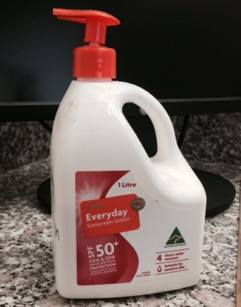
Sun Smart Policy
We ask parents to apply broad-spectrum sunscreen before leaving their child at Green Eggs
We supply sunscreen in the parent information area for parents who have not applied sunscreen to their children at home
We will ensure that all children wear hats whilst outdoors
Where a child’s own hat cannot be located, they will be provided with a laundered spare hat or guided to play in the shaded areas
We review the Sun Smart Policy annually

Slide 14
Medications Procedure
Medication Authorisation Form
Medication can only be administered by Staff at the centre when a “medication record” has been filled out and signed by the child’s Parent (via OWNA – prior to drop off, see instructions on next slide)
Prescribed Medication
Where a ‘medication record’ has been completed in OWNA, in relation to prescribed medication. This medication will be administered, where it is in a properly labelled container dispensed by a pharmacist.
Under no circumstances (including requests from parents) will staff deviate from the prescribed medical instructions for medication. Any concerns should be raised with the Director.
Safe Storage
Please ensure that medication is not left in your child's bag.
Medication must be handed to a staff member to be stored safely.

Slide 15
OWNA Creating Medication Record

Slide 16
Medications Procedure cont…
Nebulisers, Volumatics and EpiPens
Will be administered with Doctor’s instructions (these must be accompanied by a medical management plan).
Non Prescribed Medication
The Centre policy is that all non-prescribed medications e.g. cough mixture, paracetamol, topical creams/ointments and some asthma medications must be accompanied by written instructions from your Doctor before these medications can be administered. A Doctor's letter may cover a period of up to six months.
Temperatures above 37.5C
If during the day a child experiences a temperature rising above 37.5C, parents will be contacted to collect their child from the Centre. Where authorisation has been provided at enrolment, the centre can accept verbal authorisation from the parent to administer one dose only of paracetamol to provide comfort to the child.
It should be noted that, as a precaution, the centre will not administer the child’s first ever dosage of paracetamol.

Slide 17
Illness Procedure
Unwell Children
Children who are showing signs of being unwell or feeling off colour should not be left at the Centre. Sick children benefit from the care, attention and quietness of home. Your co-operation in this regard this policy will alleviate the possibility of your child spreading an infection to other children, staff and families at the Centre. Sooner or later all children get sick, so please be prepared and have a contingency plan should illness occur e.g. arrange a standby care-giver.
Children who arrive at the Centre and are obviously not well or become unwell during the course of the day will be required to be taken home.
Diarrhoea & Vomiting
Diarrhoea and vomiting are contagious, and it is our policy to follow the guidelines of Qld Health Time Out.. Guidelines state that if your child is suffering from either Diarrhoea or vomiting, regardless of the cause, they must be kept away from the Centre for 24 hours from when the last symptom appeared. This policy is in place to protect the health of all children in our care and we do not have any discretion when implementing this as a minimum standard.
Medical Clearance
A medical clearance letter from your child’s Doctor may be
required if we have any doubt about your child’s suitability
to return to the Centre.

Slide 18
Health Updates
Infectious Diseases
In the case of infectious disease, the following procedure applies;
Parents must immediately notify the centre if their child has been diagnosed with an infectious disease
All parents will be notified by the centre when an infectious disease is diagnosed in any room and information will be made available about the outbreak and the necessary precautions
Should a child contract an infectious disease, exclusion periods set down by Queensland Health (minimum exclusion periods for infectious conditions for schools, pre-schools and child care centres) will apply.
Immunisation
National Immunisation Guidelines are available via Dept of Health & Aged Care website

Slide 19
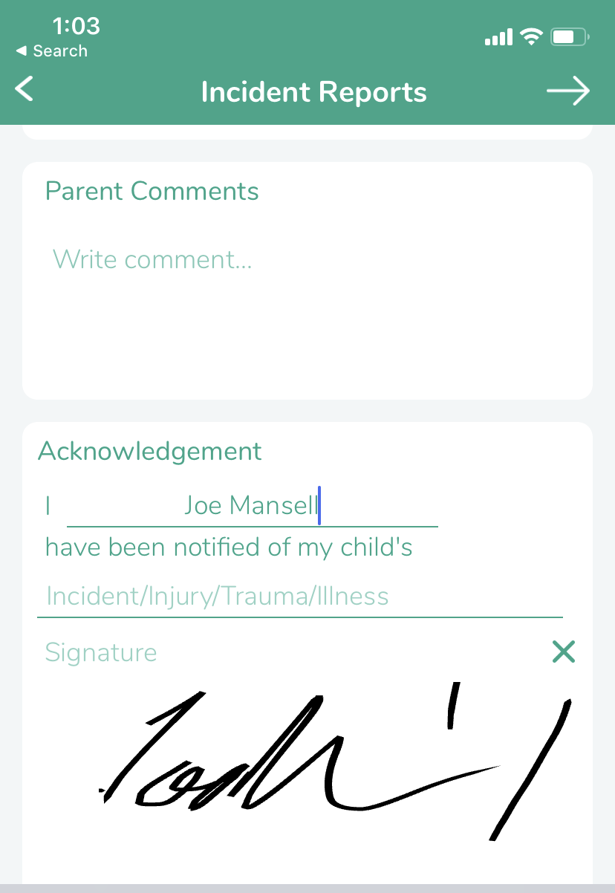
Incidents at the Centre
All senior educators are trained in first aid, CPR, Asthma and Anaphylaxis & can effectively respond to and manage accidents (incidents, injuries and trauma) which occur and illnesses that develop whilst a child is at the service. Parents will be notified (called) by the educator (witness) and an incident record will be created as soon as practicably possible following the involvement of their child in any of the of the following events.
Incident – Child is involved in an incident with another child ie hit by another child
Injury – Child suffers an injury that can be treated by staff ie abrasion/scrape
Trauma – Child suffers an injury requiring medical attention ie major cut, broken bone or concussion
Illness – child becomes unwell or has temperature
Parents will be alerted to events involving their child via the OWNA App and will be required to sign an acknowledgement of this communication. A history of previous incidents is also be available via OWNA.

Slide 20
Tour of the Service
If you have not already seen the centre, tours can be arranged via our website www.greeneggschildcare.com.au (useful links page). Please note:
Groups
The centre caters for children aged 15 months to 5 years, in the following groups:
Hours of Operation:
6:30am – 6:00pm Monday – Friday (excl Public Holidays)
10 Hour Sessions – 7:15am – 5:15pm
(with 45-minute grace period either side of session times)
ROOM | Educators | Children
Toddlers (from 15 mths - 2 years) | 2 | 8
Senior Toddlers (18 mths - 3 years) | 3 | 15
PreKindy (2.5 years - 4 years) | 3 | 25
Kindergarten ** (3.5 years - 5 years) | 3 | 26

Slide 22
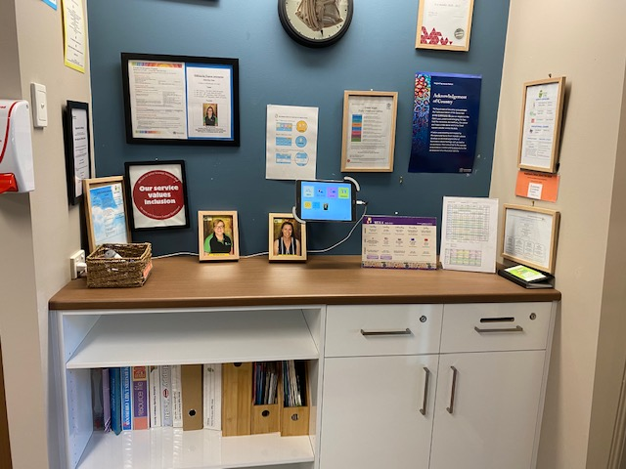
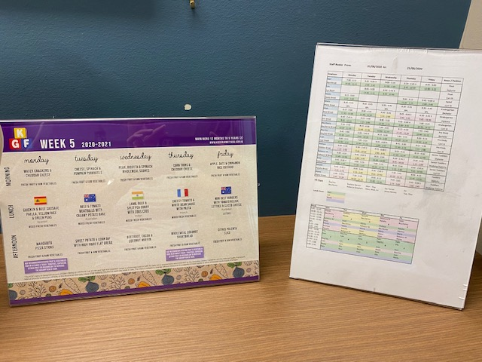
Parent Information Area
Our Parent information Area (reception) contains the following important information and notices ;
Weekly Menu, Staff Roster, Kindergarten Information, Centre Assessment and Rating, Responsible Person in Charge, Organisation Chart and much more…

Slide 23
Calendar of Events
During the year we host a number of incursions e.g. hatching program, shows, emergency services (police/fire/ambulance). These experiences are a valuable part of the children’s program as they extend concepts and provide a broad range of learning experiences.
We also enjoy hosting a wide variety of special events – Mothers Day, Fathers Day, dress-up days, family discos etc
We also have occasional visits from health care or special needs staff e.g. speech therapists, and other resource workers e.g. inclusion support, multicultural assistants etc.
All special visits are notified in advance through the newsletter, OWNA posts to families and our events calendar.
The events calendar can be found on the OWNA Parent App, these events can be added to personal (phone calendars) and sometimes require RSVP.
Please note that fees may be levied on parent accounts for some shows or events. Only children in attendance will be charged for shows. Parents will be advised prior to any surcharges made to accounts.

Slide 24
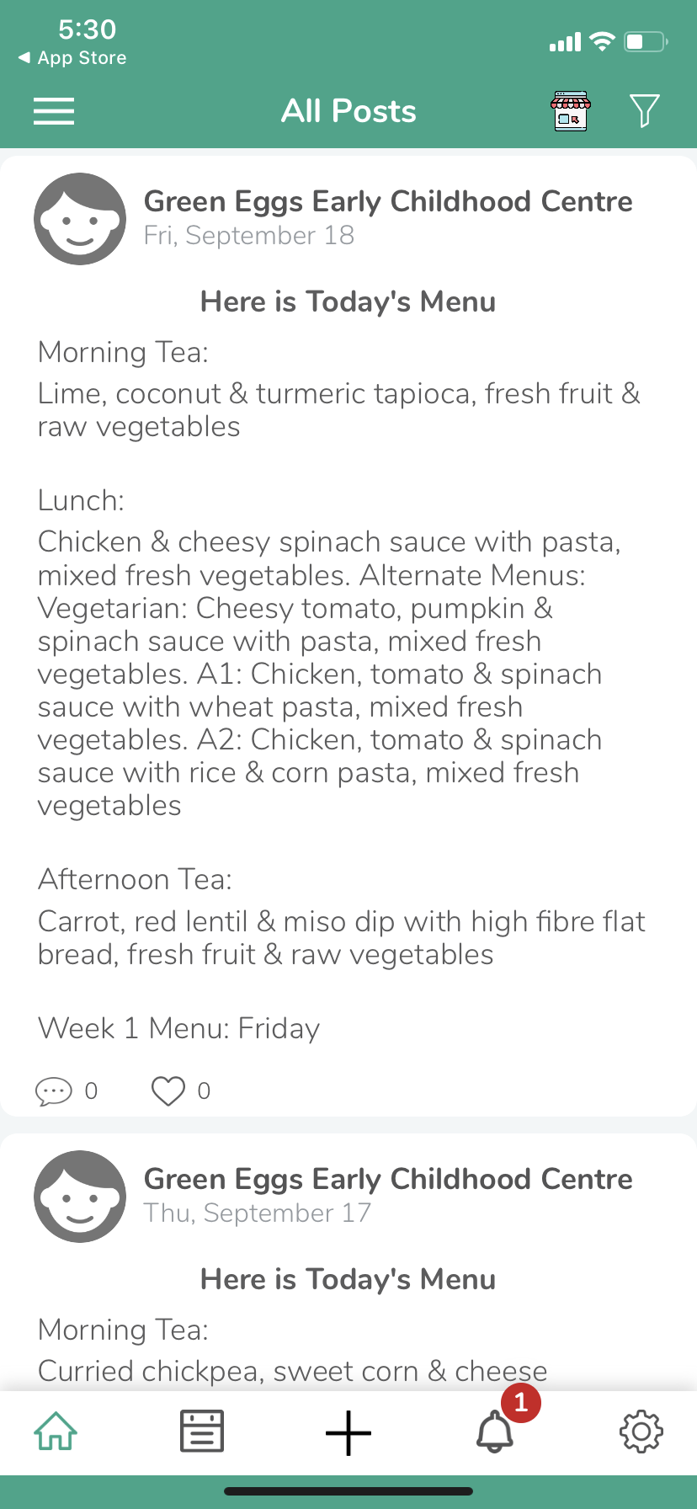
Weekly Menu
All of the Food at Green Eggs is delivered fresh daily from our external provider – Kids Gourmet Foods.
We provide healthy morning tea, lunch and afternoon tea
Menus are displayed in our Parent Information Area and can also be seen on the home screen of the OWNA Parent App each day.
Further information about Kids Gourmet Foods can be found on their website www.kidsgourmetfood.com.au

Slide 25
Example Weekly Menu

Slide 26
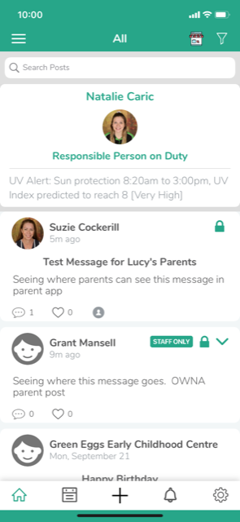
Certified Supervisor In Charge
Our Nominated Supervisor (Centre Director) Susan Mansell, Our Educational Leader (Dominique Norton) and our Approved Provider (Suzie Cockerill) work office hours and will not always be available during pickup and drop off times.
As Certified Supervisors, all of our Senior Educators can be placed in charge of the Centre in the absence of either Susan, Dominique or Suzie.
For parent information, the responsible person in charge of the Centre at any given time, can be found on the OWNA Parent App and the OWNA Kiosk (sign in/out tablet) at the centre.

Slide 27
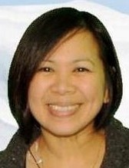
Kindergarten Program Explained
Kindergarten Program Information
Operating Times
8:30 am to 4.45pm Monday to Friday
Terms
22nd January – 28th March, 2024 (10 weeks)
15th April – 21st June, 2024 (10 weeks)
8th July – 13th September, 2024 (10 weeks)
30th September – 13th December, 2024 ( 11 weeks)
2023 TEACHER:
Mae Marfil
Graduate Diploma in Teaching
(Early Childhood Education)

Slide 28
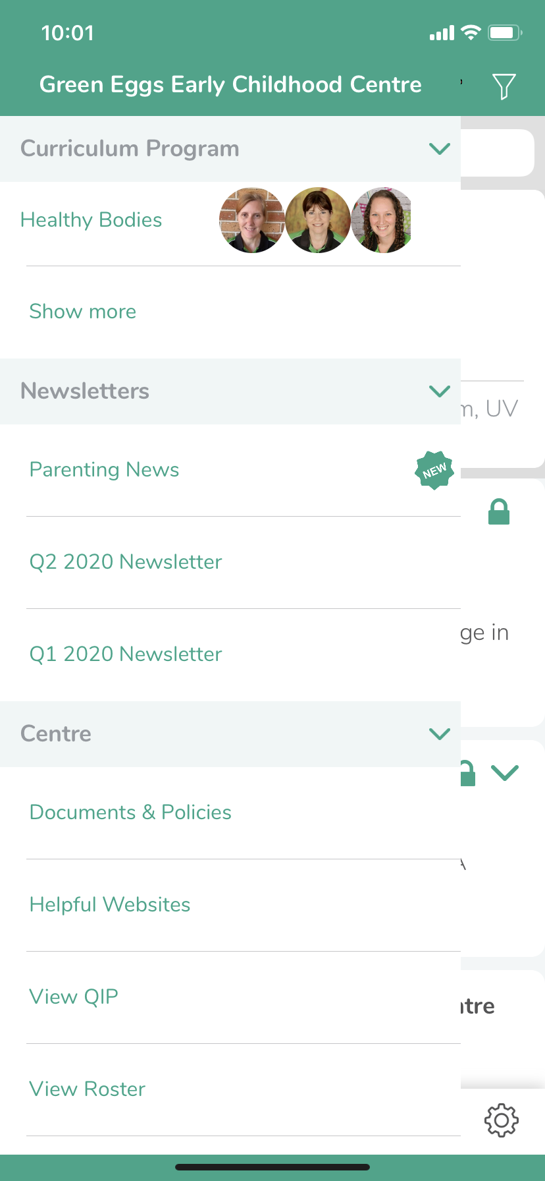
Centre Policies
Centre Policies can be found:
Under Documents & Policies – OWNA Parent App
All of our Policies, including our Centre Philosophy are reviewed biennially, parents are encouraged to participate in this review process. All feedback is welcome and encouraged.

Slide 29
Room Routine
The routine in each of our rooms varies depending on the needs of the children and with consideration to the weather conditions on any given day.
The General Routine is:
6:30 (Centre open) – 9:30 : Combined group play outside
9:30 – Transition from outdoor play to Rooms
9:30 – 10:30 : Group Time
10:30 – Morning Tea
11:00 – 12:00 : Program/Activities
12:00 – 12:30 : Lunch
12:30 – 2:30 : Rest/Quiet Time
2:30 – Afternoon Tea
3:00 – 6:00 (Centre Close) : Combined group play outside
(during winter months children will be moved inside as light fades)
Please speak to your room educator if you would like to discuss any aspects of the room routine or to obtain more detailed information, specific to your child’s room.

Slide 30
OWNA (Online Programming)
OWNA
OWNA allows families to interact and engage with our service. In addition to all of the other functions (outlined in this slideshow), parents can also use OWNA to:
- Share important information about their child
- See the daily programs
- See their child's portfolio of observations
- Comment on observations
- Share an observation from home
- Collaborate in the review and improvement of important documents such as centre policies and procedures;
-Access important centre information i.e. newsletters, events, rosters etc
Educators are notified by email when parents submit or change any details regarding their child, including comments on observations and programming activities.
Parents will be invited to access OWNA as part of the enrolment process.

Slide 31
Parent Volunteer Information
Did you know that you can become a valuable helper in your child’s classroom?
Did you know that your presence and sharing your unique experience and skills can benefit not only your child, but every child in the room?
Do you know what your child does in the day, who they play with, what activity they enjoy most?
Did you know that you only need to give a small amount of your time to make a difference?
Did you know that volunteering at Green Eggs will contribute to your “work/study” hours for the purpose of the Child Care Subsidy (CCS) Activity Test.
Please note that the success of our computer based literacy program (Reading Eggs) in our Kindergarten room each year depends on parent/carer/grandparent volunteers.
If you are interested in becoming a parent helper, in any room, please speak to your child’s educator or see our Centre Director (Susan).

Slide 32
Policy – Parental Interaction
This Policy looks at the various communication methods employed by the Centre to engage and connect with parents. It should be understood that communication is a “two way street”. It is expected that parents will be pro-active in reading centre announcements, newsletters and notices and that at least one family member is to be “active” on the Centre’s main communication system (OWNA).
This policy also outlines the Parental Grievance Procedure.
Green Eggs strives to provide the highest quality service to all children and their families. We understand that we are not perfect and at times parents may have grievances. If at any time you are not completely satisfied with the care and education provided by our Service, we encourage you to speak up. This is an opportunity for us to grow and learn from our mistakes and to put in place processes and procedures to improve our Centre. Parent forms, (including Parent Complaint Forms) can be found under “forms” in the OWNA Parent App.
Code of Conduct
Parents must adhere to the Code of Conduct for Parents/Guardians as per the Parent Handbook
In particular, parents must treat all staff with respect, it is not appropriate for parents to confront, harass or abuse staff. All exchanges should be respectful and seek positive outcomes.
Serious breaches of the Code of Conduct will result in cancellation of enrolment.

Slide 33
Policy – Relationships with Children
Our Service aims to ensure that all educators form positive relationships with children, focussing on ensuring that children feel safe and supported in the Service. Educators will encourage positive relationships between children and their peers as well as with educators and volunteers at the Service.
Our philosophy will guide our interactions with children and families with a focus on kindness as a core value.
Behaviour Guidance
Our focus is centred on the importance of respect and dignity for each child, acknowledging and accepting children’s feelings and encouraging those feelings to be expressed.
Steps that we take towards establishing good behaviour include;
Establishing and maintaining appropriate limits for behaviour
Explaining the appropriate use of materials and equipment
Reinforcing positive behaviour with praise
Explaining why certain behaviour is inappropriate or unacceptable and providing more acceptable options
Offering children choices and encouraging good decision-making
Setting realistic expectations, which are age and stage appropriate

Slide 34
Policy – Privacy & Confidentiality
Green Eggs Early Childhood Centre is committed to protecting your privacy and we abide by National Privacy Principles contained in the Privacy Act. Privacy of your personal information is important to us and we conduct our business with respect and integrity.
It is important for the centre to collect relevant personal information from parents for enrolment purposes and for the educators to maintain records of each child’s individual development. This information is predominantly of a personal nature and some of it may be considered “sensitive”. We understand that private information should not be disclosed to others unnecessarily.

Slide 35
Policy – Photography
Photographic permission is sought upon enrolment at the Centre. Please consider these authorisations carefully.
Photos of your child at various developmental stages provide the staff with evidence of milestones reached and are used to inform programming and observations.
On a yearly basis the Centre arranges for professional photos to be taken of the various Groups and individual children. You will be advised of the date in advance and provided with an opportunity to select and order the photos of your choice.
Parents photographing children (other than their own) during centre events must not post these photos on social media sites.

Slide 36
Policy – Fees (& Penalties)
A schedule of current fees is available in our foyer and under useful documents on OWNA.
It is a policy of Green Eggs Early Learning Centre to have all fees paid to two weeks in advance at all times. Fees must be paid regularly; weekly, fortnightly or monthly and always in advance.
Fees are reviewed twice a year and adjusted accordingly in the months of January and July.
Green Eggs Early Childhood Centre is an Approved Long Day Care Service under the Child Care Subsidy (CCS) System. See https://www.humanservices.gov.au/individuals/services/centrelink/child-care-subsidy
Fee Penalties
Fee Penalties apply for late collection of children (after centre close - 6:00pm), and overdue accounts.

Slide 37
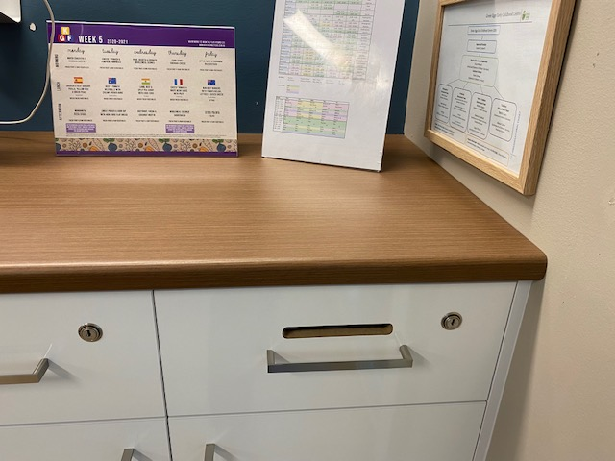
Payment Options
Payment Options
Our preferred method of payment is direct bank transfer.
This can be setup through your internet banking with
regular payments to the Green Eggs bank account:
ANZ
BSB: 014 02
Account: 902958111
(invoices are updated in OWNA on either Mondays or Tuesdays each week, our account details for payment can be found on family invoices)
Alternatively, you may use EFTPOS facilities in our reception or setup a Credit Card or Bank Authority via OWNA for direct debit (weekly or fortnightly). Don’t forget to put your surname on the EFTPOS receipt and place it in the “office mail”.

Slide 38
Facebook
Facebook isn’t for everyone, however, if you enjoy social networking, please “like” us on Facebook so that our posts can be picked up in your news feed.
We can be found at www.facebook.com/GreenEggsChildCare
Photography Authority
We respect your right to privacy. As such, photos of your child will not be placed on Facebook unless you “opt in” via the enrolment photography authorisation.

Slide 39
Details provided at Enrolment
Your electronic enrolment contains critical medical and contact information for your child. Please ensure that these records are kept up to date at all times whilst your child is enrolled at Green Eggs.
The centre must be advised if:
You have moved
Your contact details have changed
Custodial arrangements have changed
Your child has a been diagnosed with a medical condition, requiring a medical plan i.e. allergy, asthma, diabetes etc
You are experiencing financial hardship (assistance may be available in certain circumstances)
Your emergency contacts have changed
Authorised collectors for your child have changed
You become aware of other matters that may be relevant to support the education and care of your child.

Slide 40
Enrolment Process/Interview
The enrolment process at Green Eggs involves the following key steps:
Enrolment Position is offered in person or via email
Enrolment Position is accepted by the family
Bond (for January enrolments) and/or enrolment fee paid
Enrolment Confirmation Email - URL for Online Enrolment Form emailed with further information for families
Family to review Parent Orientation Slideshow (per enrolment confirmation email)
Family to book transition visit for their child (per enrolment confirmation email)
Family to book a pre-enrolment interview (per enrolment confirmation email)
The pre-enrolment interview is only a requirement for families requiring additional enrolment paperwork – for children with special dietary requirements and/or children with special medical conditions to discuss with the Centre.
All other families are welcome to (optionally) book in for a pre-enrolment interview to meet with our Centre Director, Susan Mansell for any reason.
To book:
https://enrolment.timetap.com/

Slide 41
Transition Visit
To assist children with their transition from home to our Centre, we encourage at least one transition visit prior to their first day at Green Eggs.
Transition visits help children to understand that the Centre is a safe and secure environment. They also allow educators and parents to get to know each other and to share information. This relationship, and the information shared (between educators and parents), is critical to the success of the early childhood educational experience.
If you have not already done so, please use the following link(s) to book your room-specific transition visit(s):
https://toddler.timetap.com
https://seniortoddlers.timetap.com
https://prekindy.timetap.com
https://kindergarten.timetap.com

Slide 42
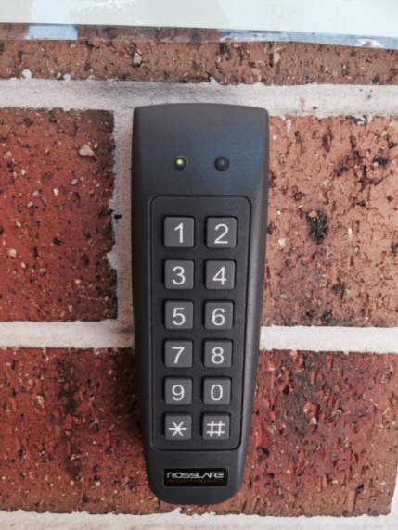
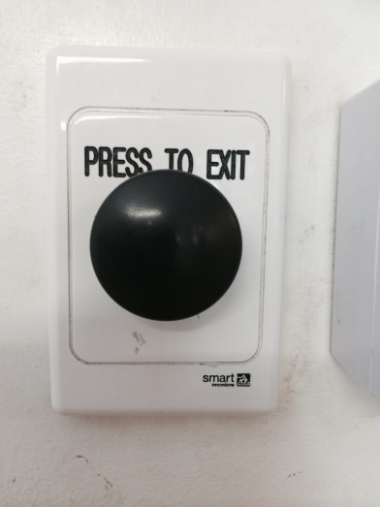
Centre Pin Code
Just beside our front door you will see a keypad – to release the front door you will need to enter our Pin Code – if you do not have the Pin Code, please press the bell and you will be assisted by a staff member.
Don’t forget to press the button to exit on your way out!
For safety reasons, parents must NOT allow their children to press this button to exit the centre AND parents must not allow strangers to follow them into the centre.

Slide 43
QUESTIONS
This Slideshow is intended to give you valuable information to support your experience at Green Eggs. We are happy to talk to you if you have any questions or concerns about the content of this orientation package or any other matter.
CONTACT US
Phone: (07) 3349 3233
Email: director@greeneggschildcare.com.au
Address: 72-78 Ham Rd, Mansfield QLD 4122

